Slide 1
Overview
Communication is the transfer of information from one place to another.
This should be done
- as efficiently as possible
- with as much fidelity/reliability as possible
- as securely as possible
Communication System: Components/subsystems act together to accomplish information transfer/exchange.

Slide 2
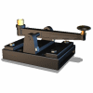
Brief Chronology of Communication Systems
Two developments in the field of electricity
First, in 1800, the Italian physicist Alessandro Volta invented the battery
Second, in 1820, the Danish physicist Hans Christian Oersted demonstrated the connection between electricity and magnetism
In May 24, 1844 Samuel Morse transmitted the first public telegraph message

Slide 3
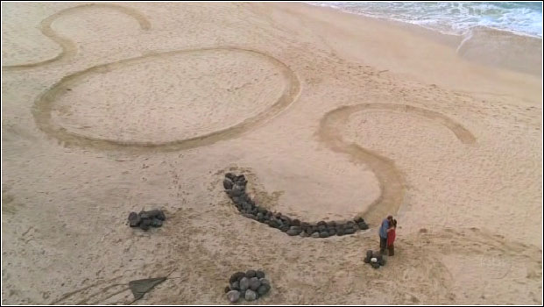
DID YOU KNOW “SOS”?
Internationally
accepted
Distress signal
EARLY FORMS OF LONG-DISTANCE COMMUNICATION

Slide 4
Brief Chronology of Communication Systems
1874 Thomas Edison invented quadruplex telegraphy
1876 Alexander Graham Bell invented the telephone
1906 First wireless communication of human speech
1936 First television broadcast made in London, England
1938-1945 World War II Radar and microwave systems
1941 Z3 computer developed by German engineer Konrad Zuse
1948-1950 Information Theory and coding. C. E. Shannon
1957 Satellite communications begins with Sputnik I. Russia
1962-1966 High Speed digital communication
1972 Motorola develops cellular telephone.
1994 High Definition TV standards agreed on in the U.S.
1999 Intel introduces the Pentium III processor, taking personal computing to new highs.
2050 ......??? Tell me where you think we will be in the year 2050

Slide 5
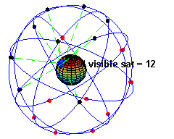

Slide 6
Types of communication
verbal, nonverbal…
Analogue communication
modulation: amplitude modulation (am), frequency modulation (fm), phase modulation (pm)
Digital communication
modulation: Frequency Shift Keying (FSK), Binary Phase Shift Keying (BPSK), Quadrature Phase Shift Keying (QPSK)

Slide 7
Elements of a Communication System
Input Transducer
Output Transducer
Input message
Transmitter
Channel
Receiver
Output message

Slide 8
Input Transducer: The message produced by a source must be converted by a transducer to a form suitable for the particular type of communication system.
Example: In electrical communications, speech waves are converted by a microphone to voltage variation.
Transmitter: The transmitter processes the input signal to produce a signal suits to the characteristics of the transmission channel.
Signal processing for transmission almost always involves modulation and may also include coding. In addition to modulation, other functions performed by the transmitter are amplification, filtering and coupling the modulated signal to the channel.

Slide 9
Channel: The channel can have different forms: The atmosphere (or free space), coaxial cable, fiber optic, waveguide, etc.
The signal undergoes some amount of degradation from noise, interference and distortion
Receiver: The receiver’s function is to extract the desired signal from the received signal at the channel output and to convert it to a form suitable for the output transducer.
Other functions performed by the receiver: amplification (the received signal may be extremely weak), demodulation and filtering.
Output Transducer: Converts the electric signal at its input into the form desired by the system user.
Example: Loudspeaker, personal computer (PC), tape recorders.

Slide 10
Elements of a digital communication systems
Noise
Transmitted
signal
Received
signal
Received
info.
Source
Info.
User
SOURCE
Transmitter
Channel
Receiver
Transmitter
Source
encoder
Channel
encoder
Modulator
Receiver
Source
decoder
Channel
decoder
Demodulator

